Slide 1
Vintage Market
By Su Zhang
Notes:
My app is called Vintage Market. The idea for this app comes from climate change.

Slide 2
Fast Fashion & Climate Change
Notes:
A major cause of climate change that remains overlooked is clothing.
Society values the latest trends, the most fashionable clothing and the most stylish looks, and we rarely think about the environmental impact of our shopping habits.
The desire to supply the latest fashion trends in abundance at low prices has led to the fashion industry becoming one of the world's major polluting industries.
气候变化的一个主要原因仍一直被忽视，那就是服装.
社会重视最新趋势、最时尚的服装和最时尚的外观，我们很少考虑购物习惯对环境的影响。
渴望以低廉的价格大量供应最新的时尚潮流，这导致时尚产业成为世界主要污染产业之一。

Slide 3
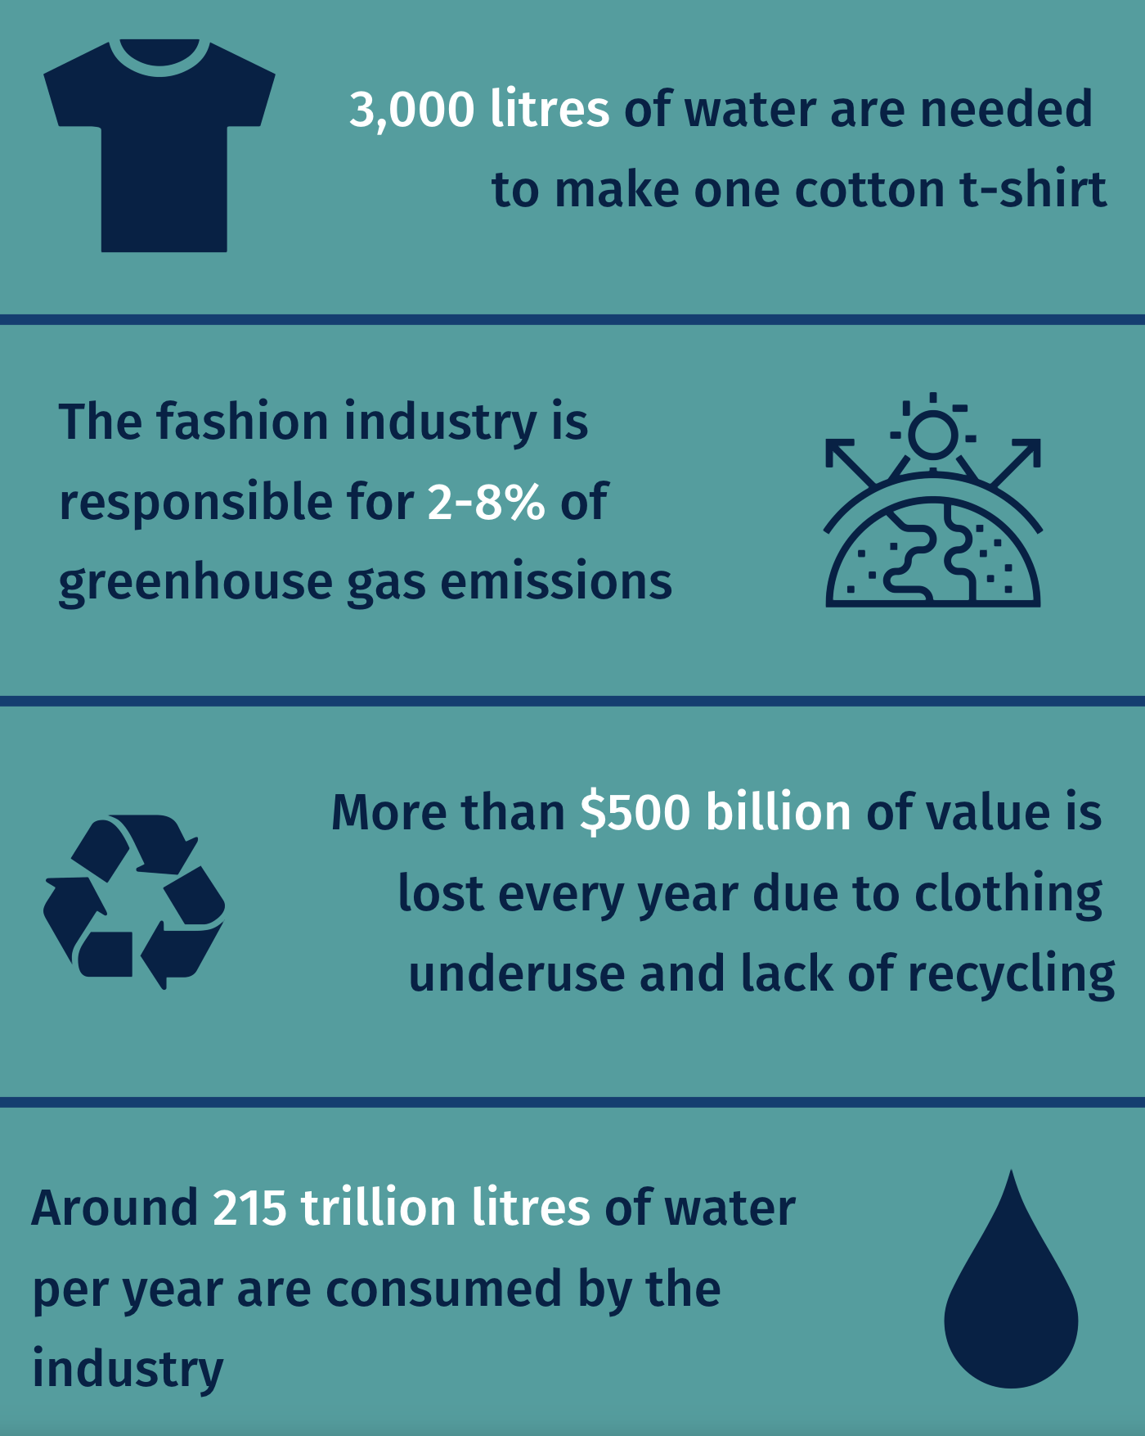
How does clothing affect climate change?
High water consumption
Chemical contamination from dyeing and processing
Incineration or landfill disposal of large quantities of unsold or discarded clothing
Notes:
In recent years, retail brands have seen an increase in the number of new styles each season, with some fashion brands launching several times a week.
This is a kind of "fast fashion" where things are cheap and thrown away.
Only about 20% of clothing is recycled or reused, while a large number of fashion products end up in landfill or incineration, resulting in huge carbon emissions
But as a consumer, shopping habits are part of the solution and can make our world a better place.
近些年，零售品牌每一季的新款数量都有所增加，有些时尚品牌每周上新好几次。这是一种“快时尚”，东西便宜，穿完就扔。只有大约20%的服装被回收或再利用，而大量的时尚产品最终则被填埋或焚烧处理,造成了巨大的碳排放
但作为消费者其实仅仅通过购物习惯这一点，就已经是问题解决方案的一部分了，同时也能让我们的世界变得更美好.

Slide 4
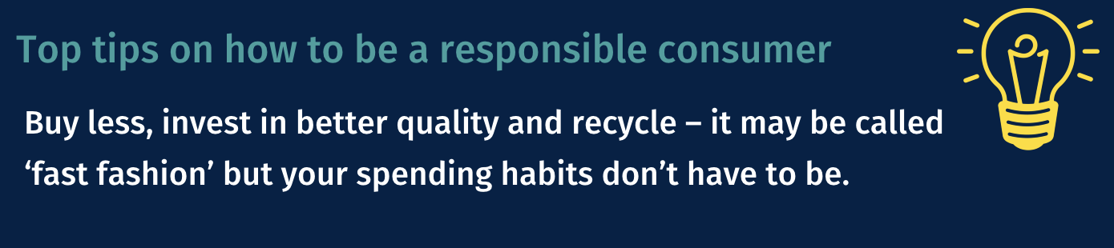
How can you combat climate change through clothing?
Reduce consumption and waste
Avoid disposables and fast fashion, and try not to buy more than you need
Buy quality products that are built to last
Choose green and eco-friendly brands
Repair and Reuse
Donate unwanted items to charity or sell them to give them a new lease of life
Notes:
Let's take a look at what we should do to combat climate change through clothing:
Consumers can do more by converting purchased clothes into second-hand or online for resale,
Rent and mend clothes for special occasions instead of throwing them away, striving to prolong the life of all clothes
Donate unwanted items to charity or sell them to give them a new lease of life,
Choose green and eco-friendly brands
让我们来看一下应该怎样做可以通过服装来应对气候变化：
消费者可以通过将购买的衣服更多地转换成二手或网上转售，
在特殊场合租用以及修补衣服而不是扔掉，努力延长所有衣服的使用寿命
将不需要的物品捐赠给慈善机构或出售，让它们重获新生，
挑选绿色环保的品牌

Slide 5
https://vintagemarket.herokuapp.com/
90% OFF
1st purchase only
Notes:
The most important point is to purchase lots on my website
This is my website address
最重要的一点是要多在我的网站上消费，
这是我的网站地址

Slide 6
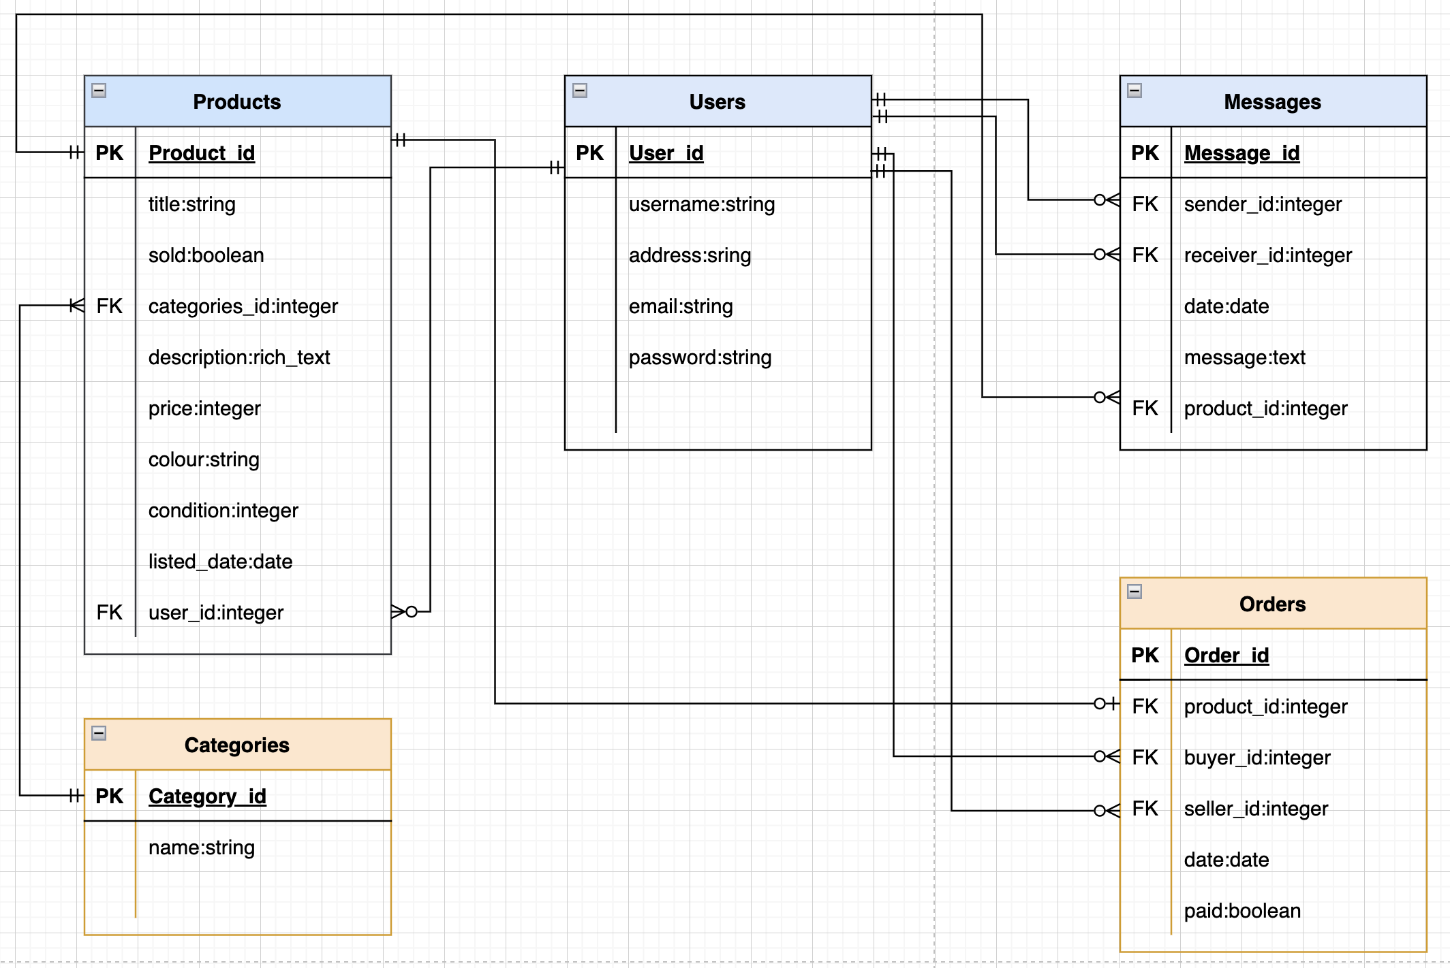
ERD
Notes:
This is the ERD of my app, I have 5 entities, they are product, user, message, order, and category.
A User has a zero to many relationship with product. Product has one and only one user.
A user can send or receive zero to many messages. A message has one and only one sender and receiver.
A user can have zero to many orders. Orders have one and only one buyer as a user and one and only one seller as a user.
A message has one and only one product. A product has zero to many messages.
A product has zero or one orders. Orders have one and only one product
A product has one and only one category. A category has one to many products.

Slide 7
Wireframes
Notes:
The wireframes of my app

Slide 8
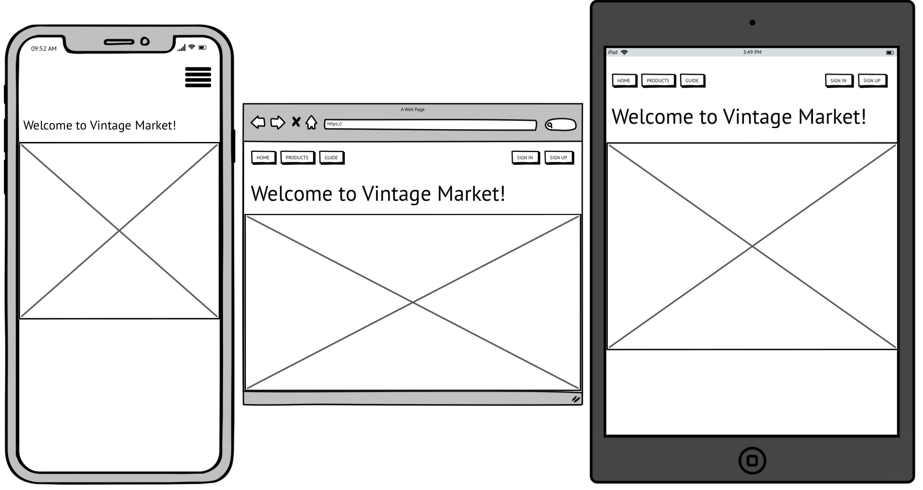
Home page – signed out
PRODUCTS
SIGN UP
HOME
GUIDE
HOME
Hamburger menu
Notes:
This is the home page when not signed in:
On the top of the page is the navigation bar, it uses a partial file, so that it can be included on every page of the site.
The Navigation bar includes Home, Products, Guide, sign in and sign up buttons
I designed a hamburger menu for smaller screens
Under the navbar is a main background picture

Slide 9
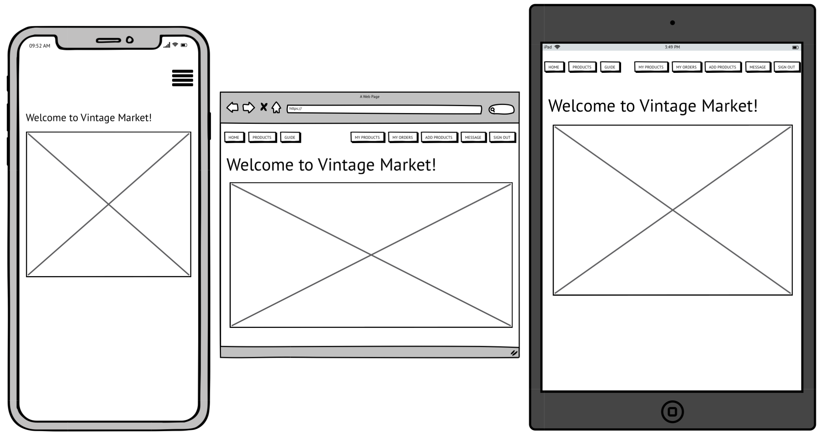
Home page - signed in
MESSAGES
MY ORDERS
SIGN OUT
MY PRODUCTS
ADD PRODUCTS
Notes:
When a User is signed in,
A User will be able to see more features ,including : my products, my orders, Add new product and messages.

Slide 10
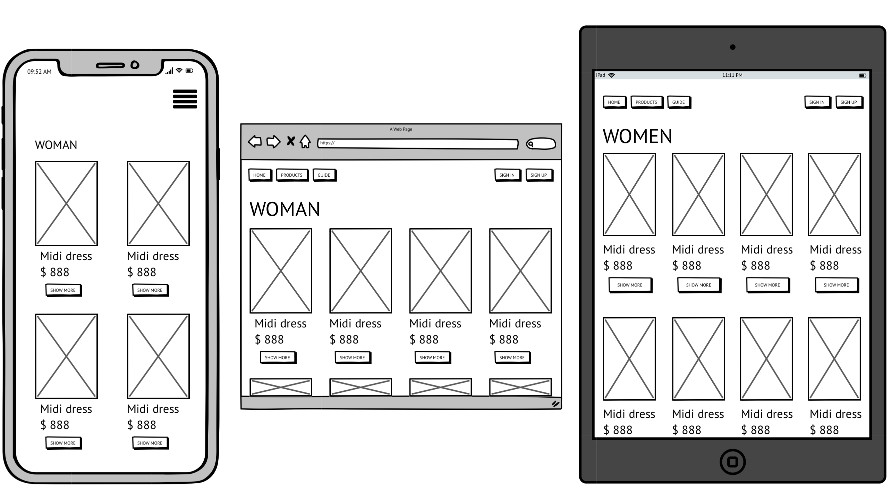
Products page
Product Section Title
Product Picture
Title
Price
Show More
Notes:
When you click on the products button, it will take you to the product page, where you can see all products.
Each section is divided by the product section title
Every product includes a relevant picture of the product, title and price, if User haven’t uploaded any picture, it will show a default picture
The Show More button links to the corresponding product page

Slide 11
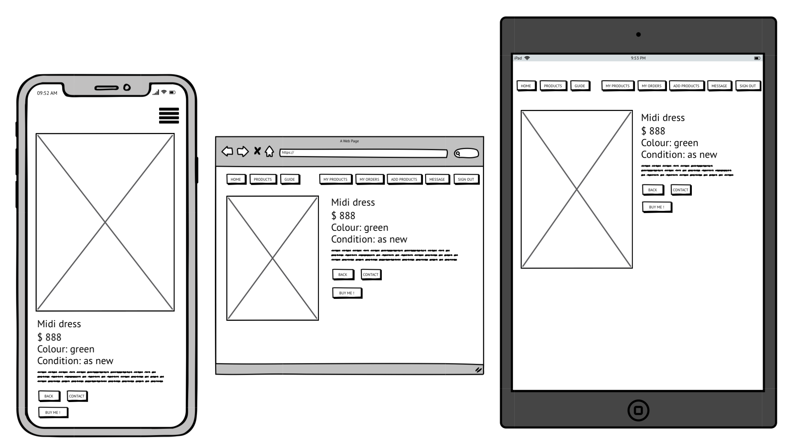
Product page – as a buyer
Product Picture
BUY ME !
Title
Price
BACK
Colour
CONTACT
Condition
Notes:
In this page, as a buyer, a User can send a message to a seller or purchase this product. but without signing in, a User only can browse and go back to products main page

Slide 12
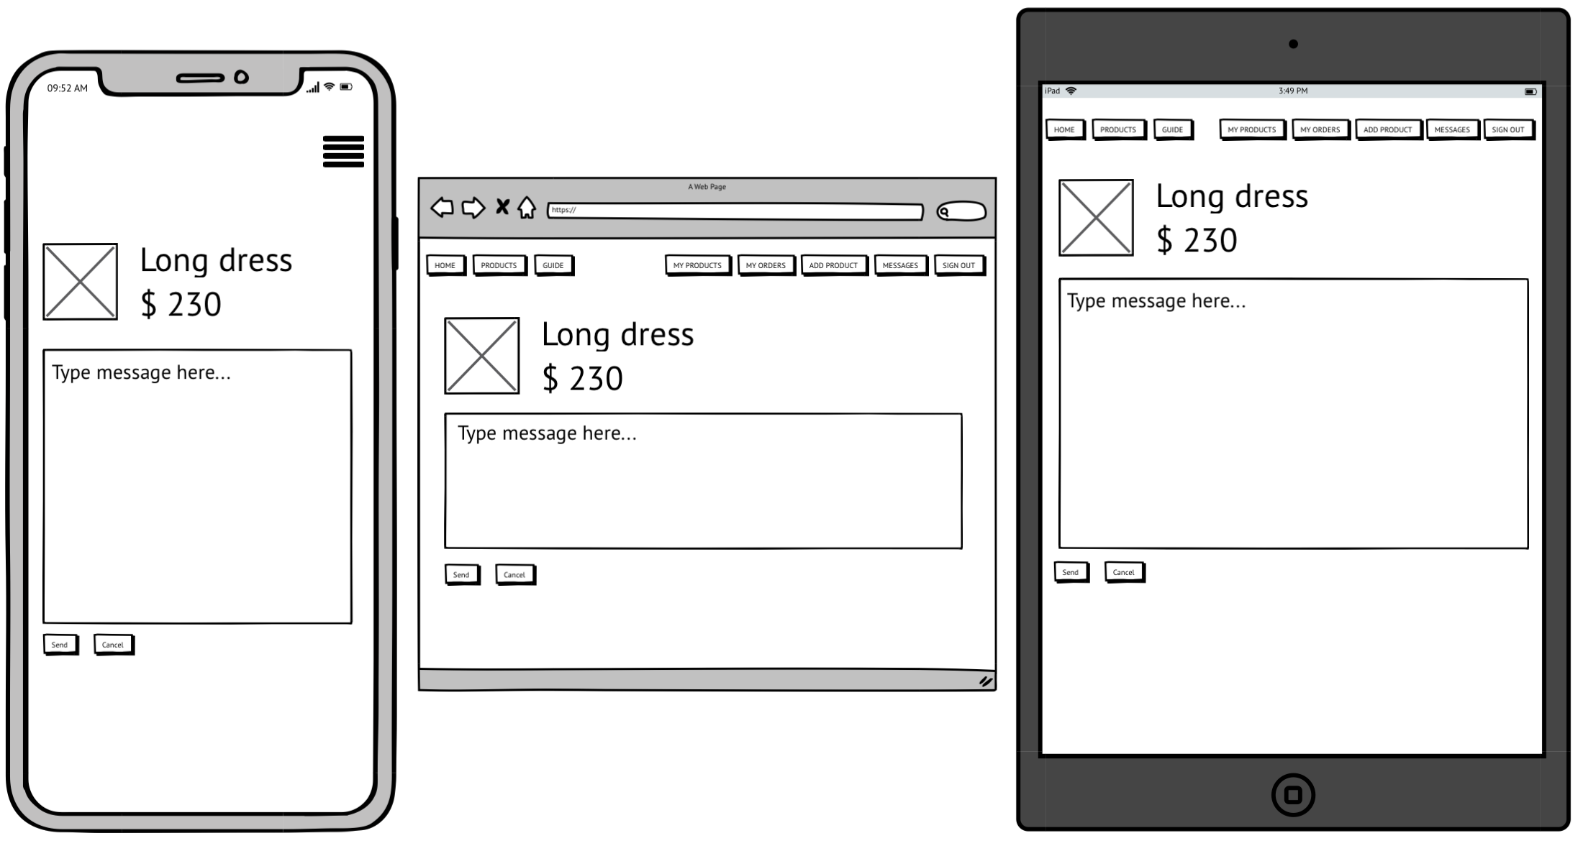
Message Page
Product information
MESSAGE
Send
Cancel
Notes:
Clicking on the message button, will link to this page, a User can send a message to seller.

Slide 13
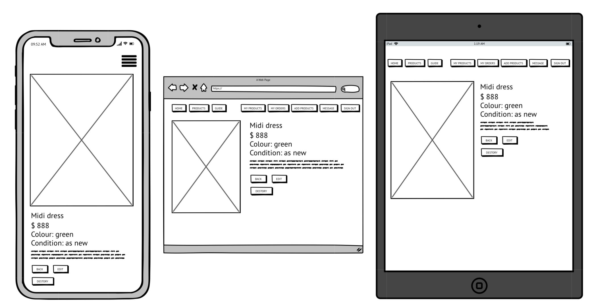
Product page – as a seller
DESTORY
BACK
EDIT
Notes:
As a seller, a User will be able to edit or delete their product.

Slide 14
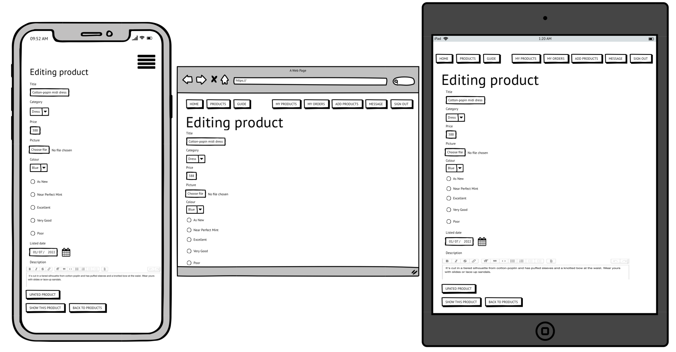
Editing Product Page
UPDATE PRODUCT
BACK TO PRODUCTS
SHOW THIS PRODUCT
Notes:
When a User clicks on the edit button it links to this editing page,
A User can update their product information in this page.

Slide 15
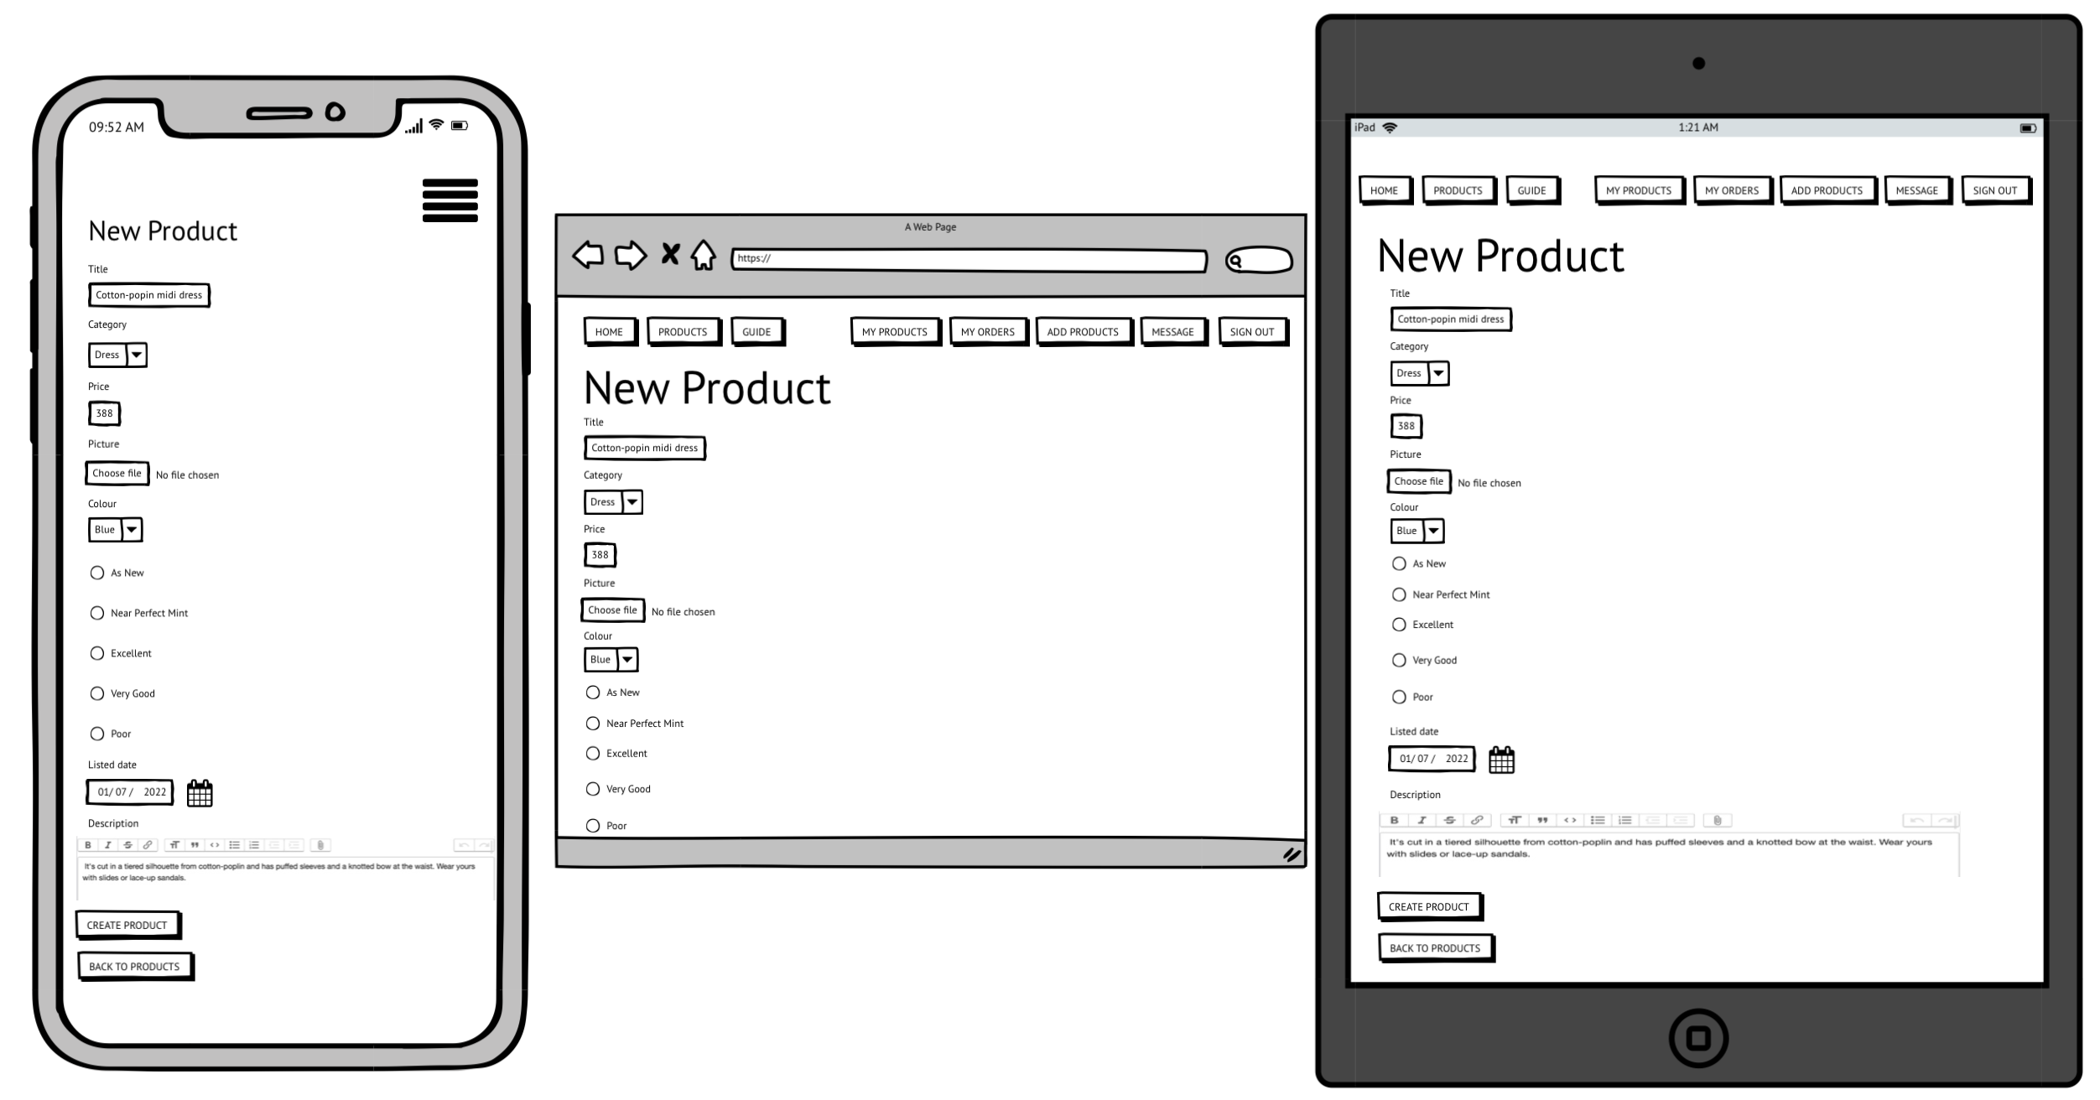
Add New Product Page
ADD NEW PRODUCT
CREATE PRODUCT
BACK TO PRODUCTS
Notes:
To Create a new product a User can click the Add new product button in the nav bar

Slide 16
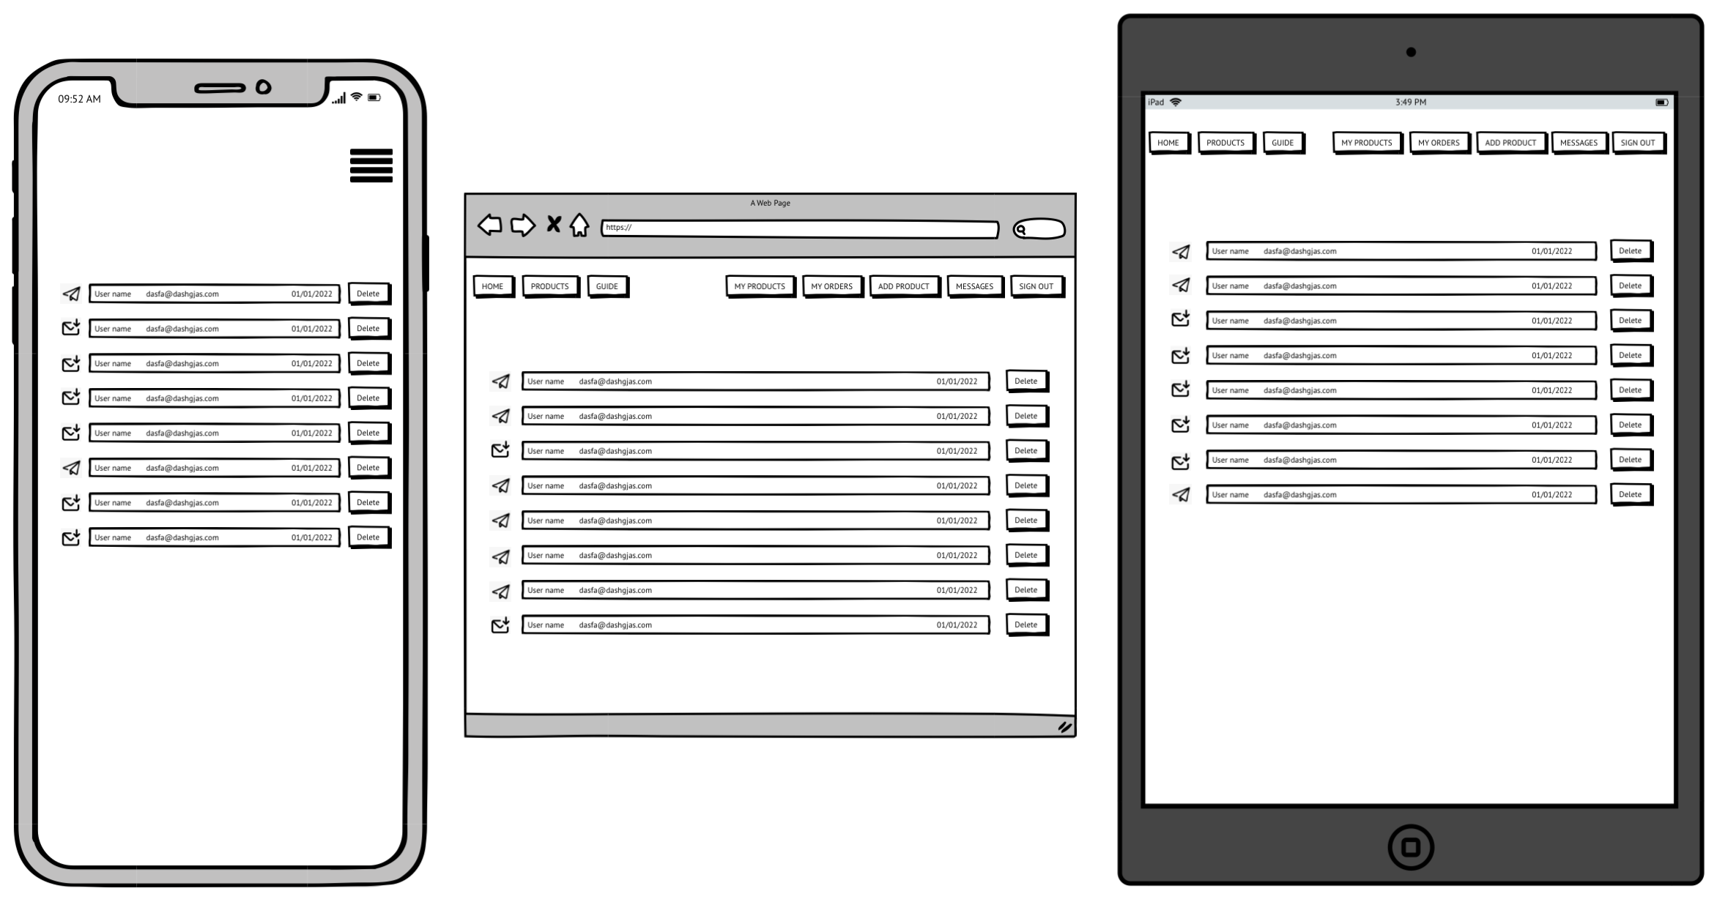
Message listing page
MESSAGE
DELETE
Notes:
A User can check their message from buyers by clicking the message button,
A User will be able to view all sent and received messages in this listing page.

Slide 17
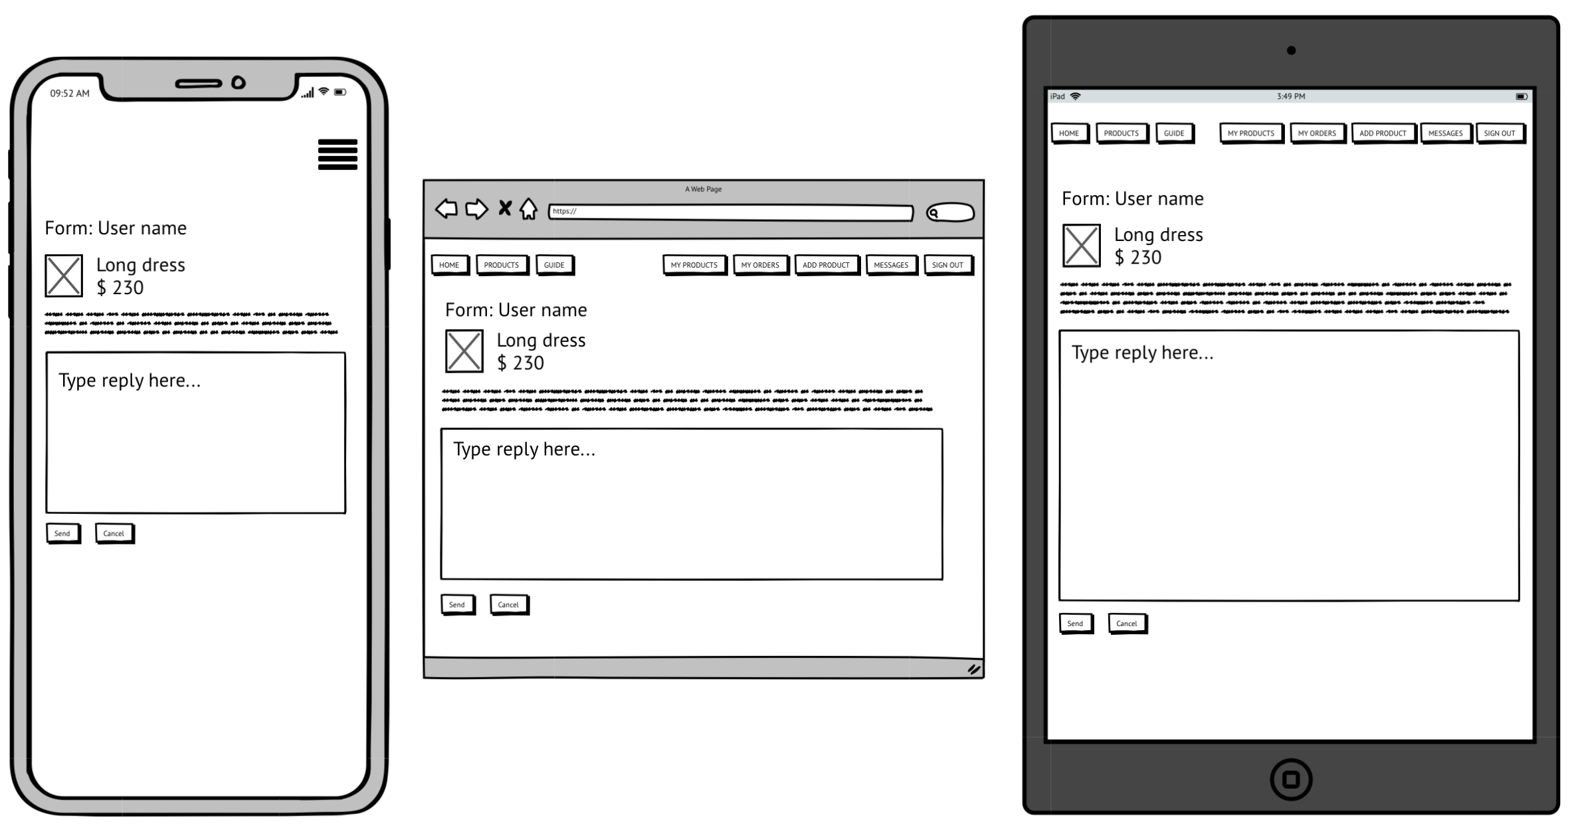
Message page
User and product information
MESSAGE
Cancel
Send
Notes:
Clicking on one of the messages on the message listing, will link to this page, a User can read or reply to the message.
And also the User will be able to see the related product information

Slide 18
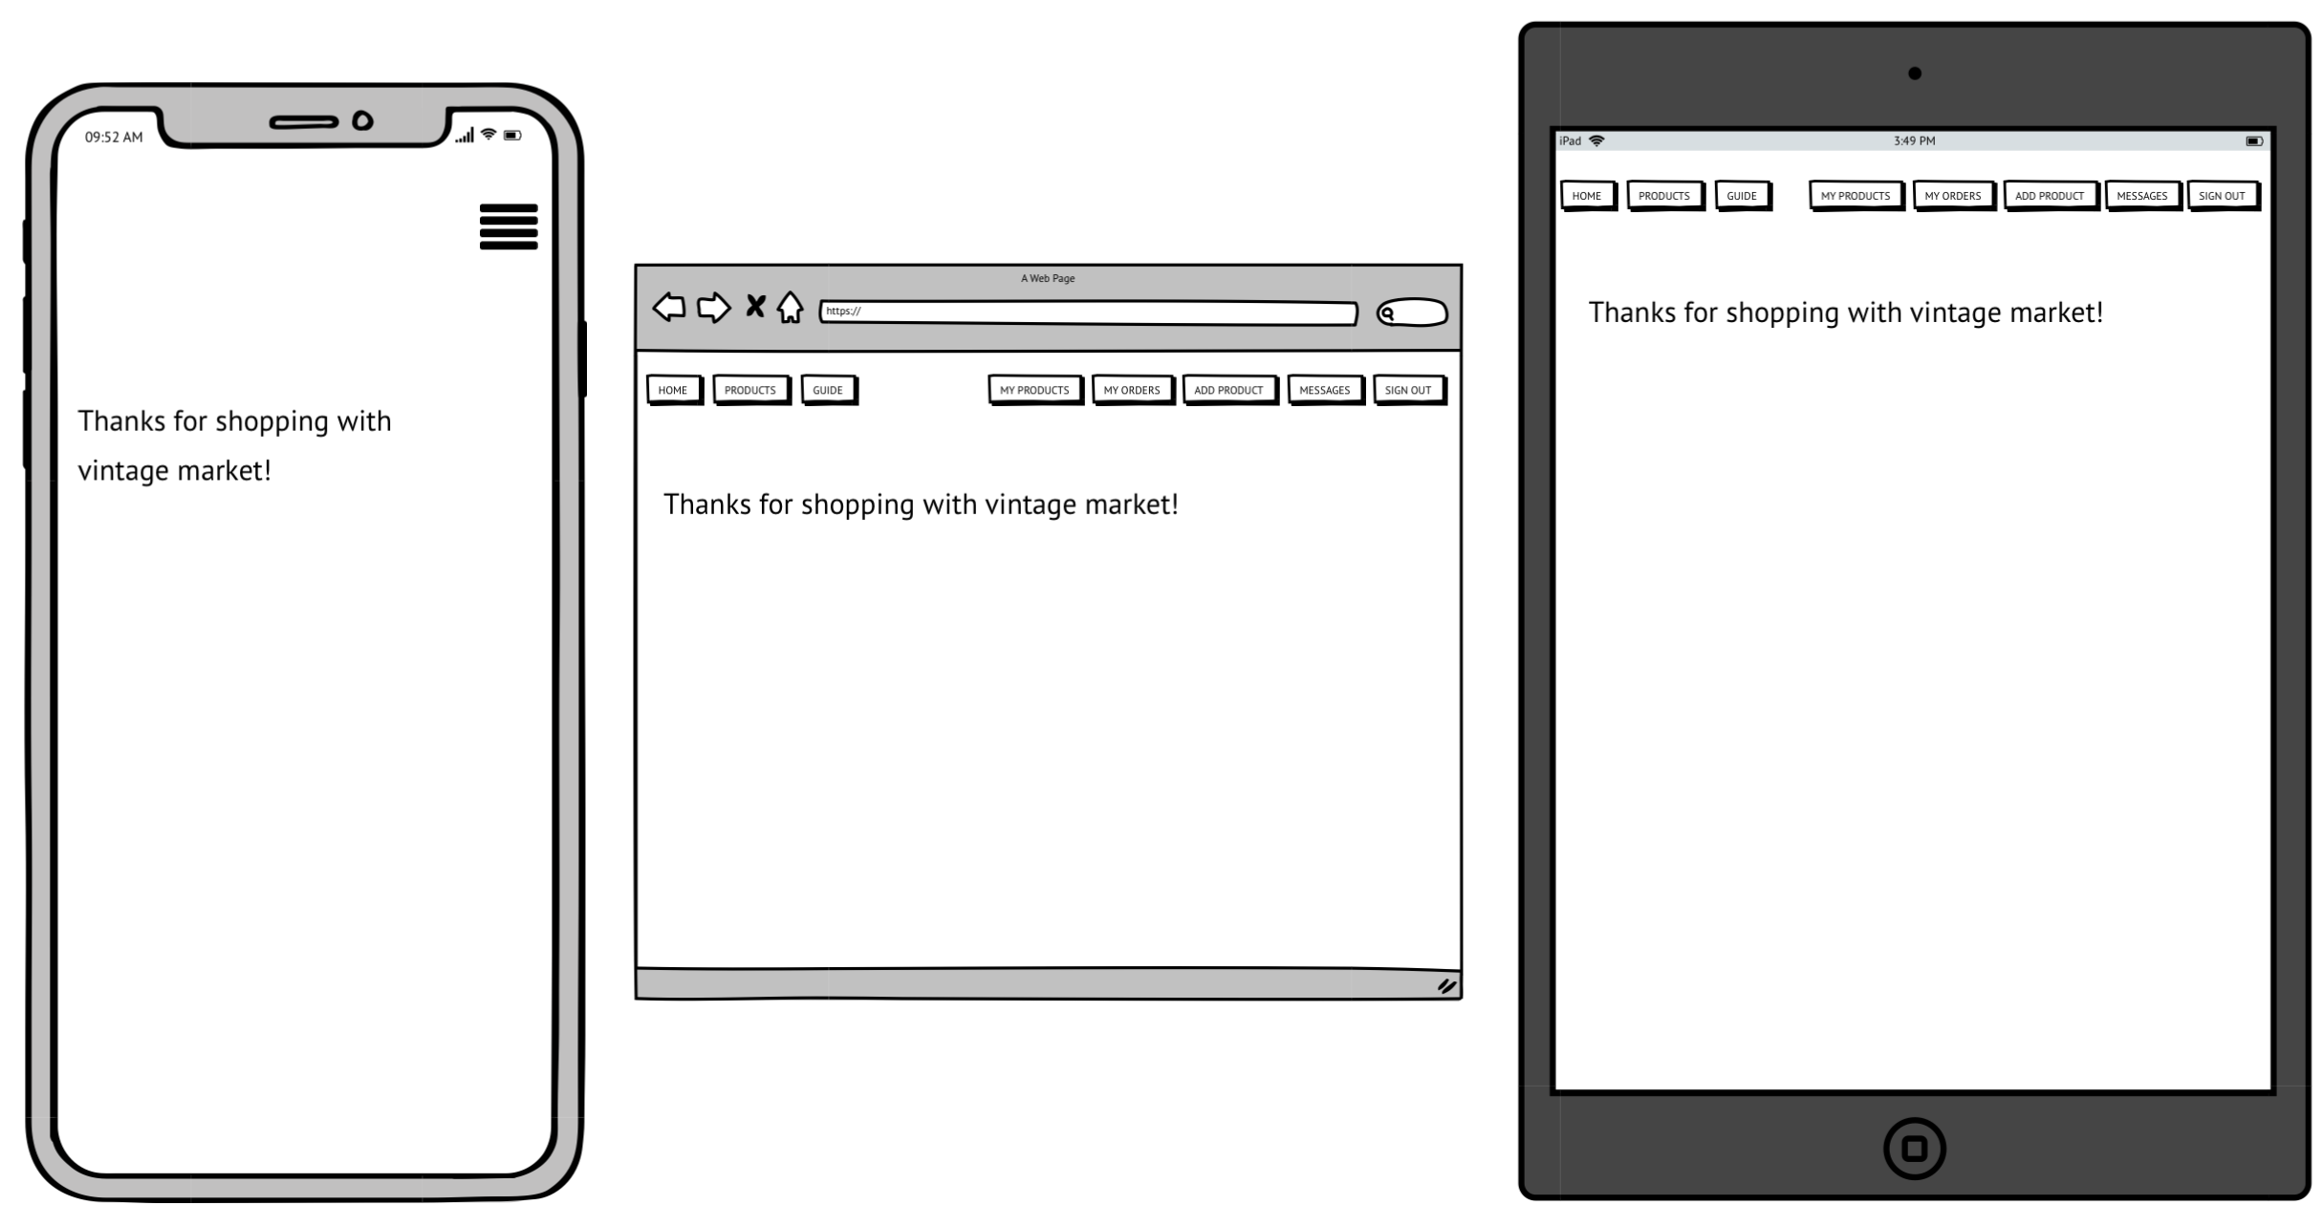
Success Page
Notes:
This is the successful message after a buyer has bought the product

Slide 19
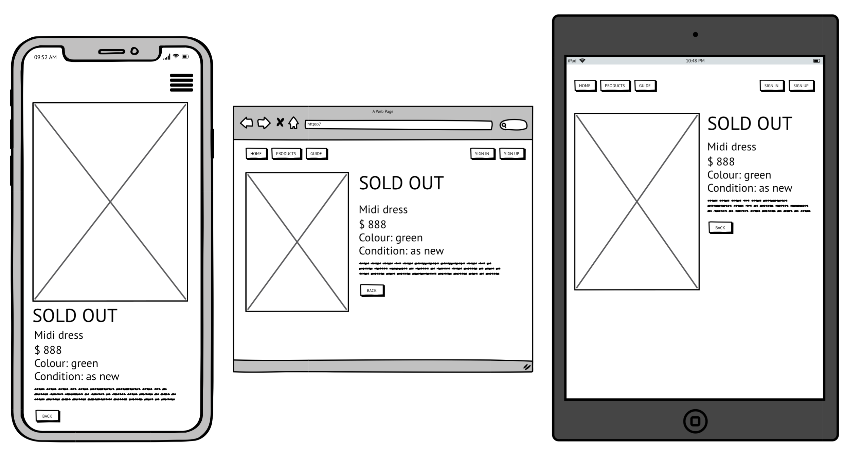
Sold out page
Notes:
If the product is sold out, it will show a sold-out message and a User can only go back to products page

Slide 20
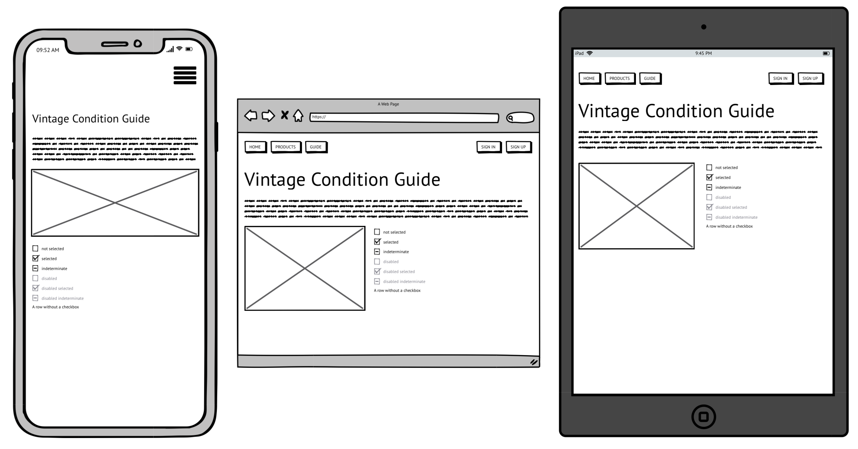
Guide page
Clothes Condition information
Condition Terms Definition
Notes:
This is the guide page
This page defines the condition terms of this website.

Slide 21
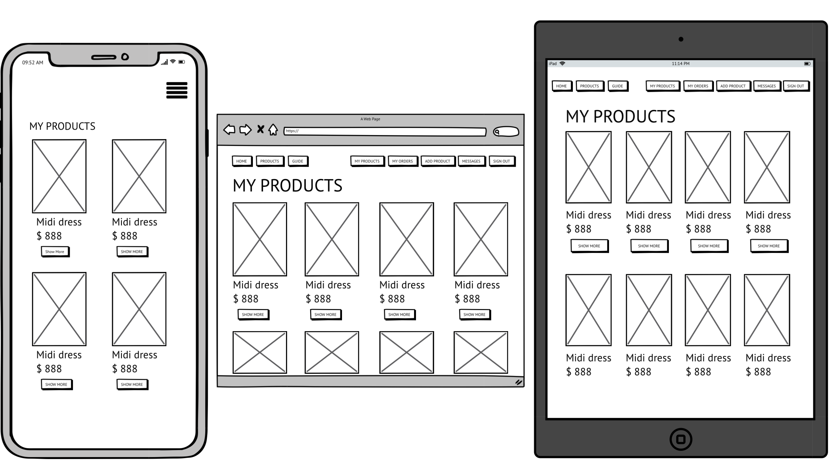
My products page
PRODUCTPICTURES
MY PRODUCTS
Notes:
This page shows all uploaded products from the currently signed in seller

Slide 22
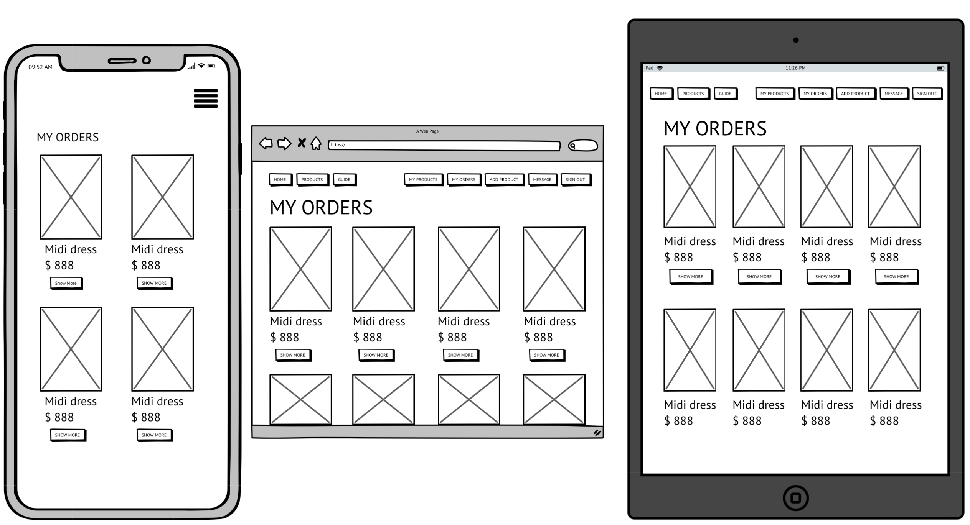
My order
PRODUCTPICTURES
MY ORDERS
Notes:
This page shows all orders from a buyer

Slide 23
A walkthrough of my app
Notes:
A walkthrough of my app

Slide 24
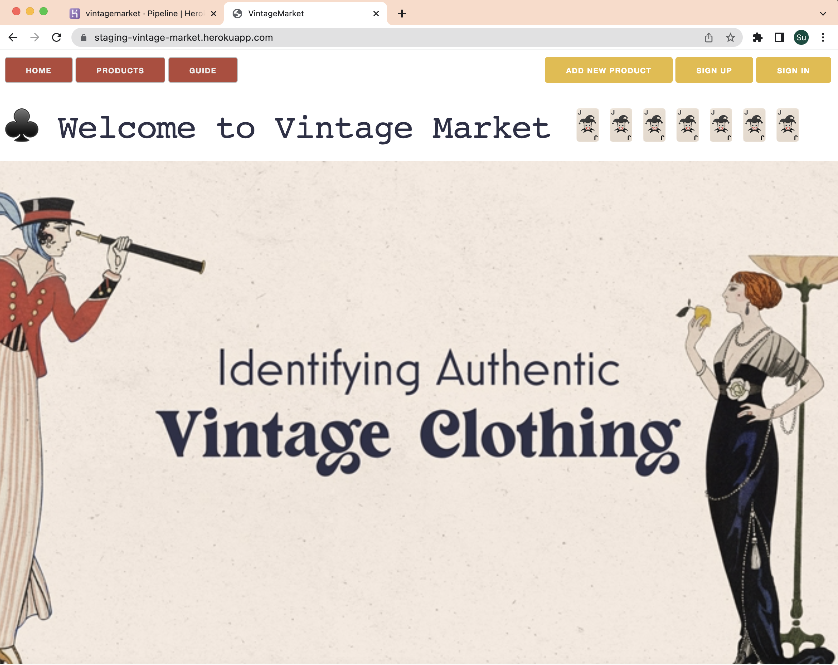
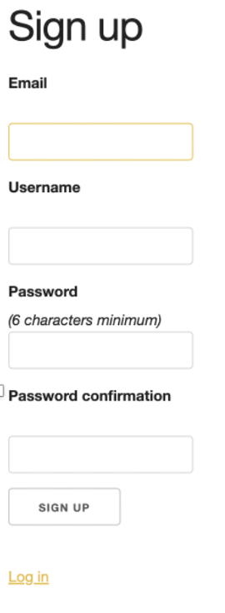
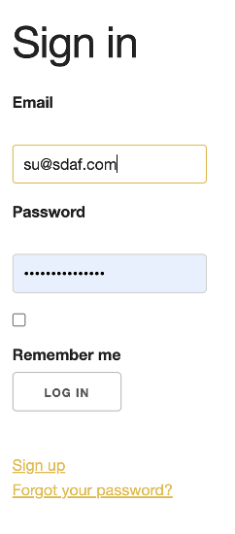
Notes:
This is my home page
You can click on the sign up or sign in buttons to register or logon to the site.
All navigation is on the top of the page.
I still have 3 features, ”My products”, “My orders” and ”Messages” that I am currently working on and will also be the nav bar

Slide 25
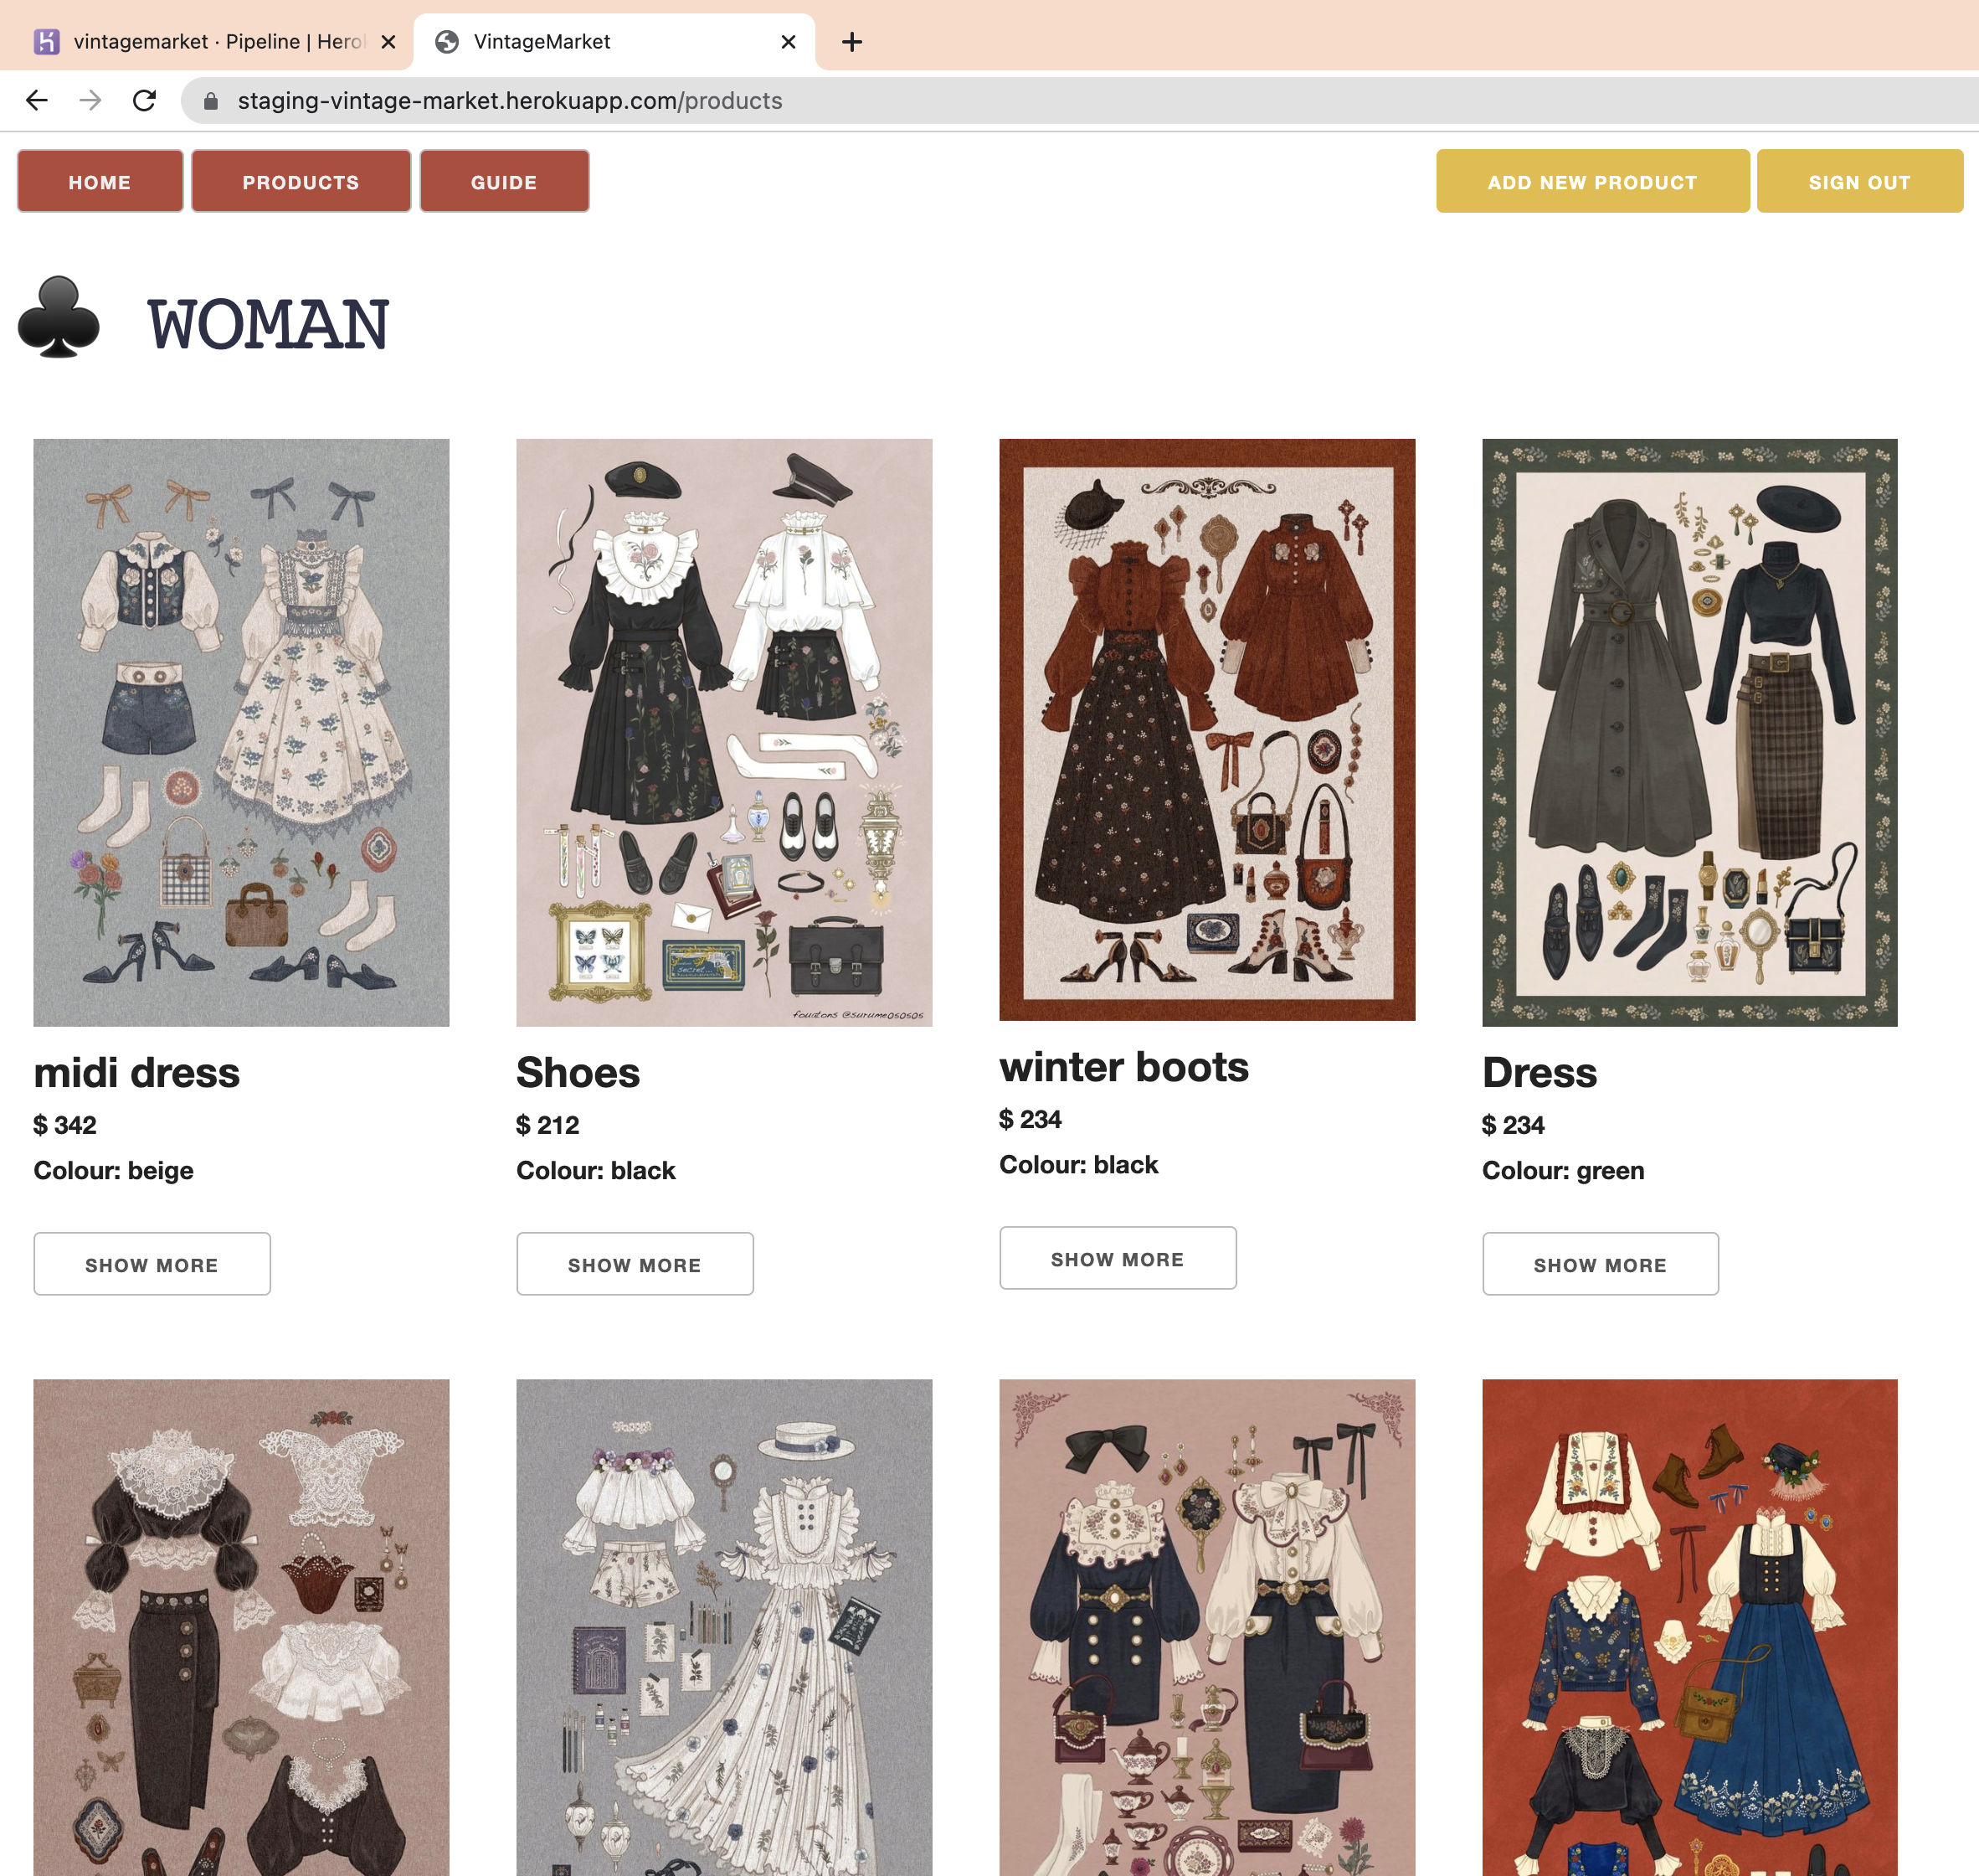
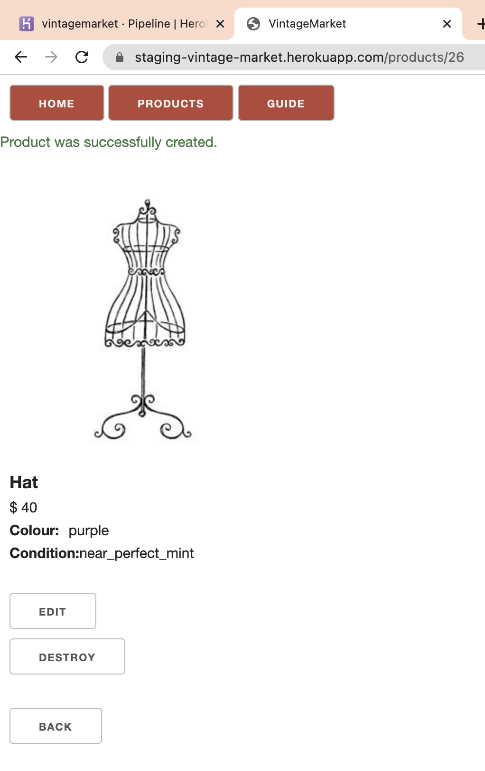
Notes:
When you click on the products button you will be linked to the product page.
I decided to use 4 photos to a row layout.
To see more details about a product a User can click the show more button.
The right photo shows a what a product without a photo looks like. It uses a default image.

Slide 26
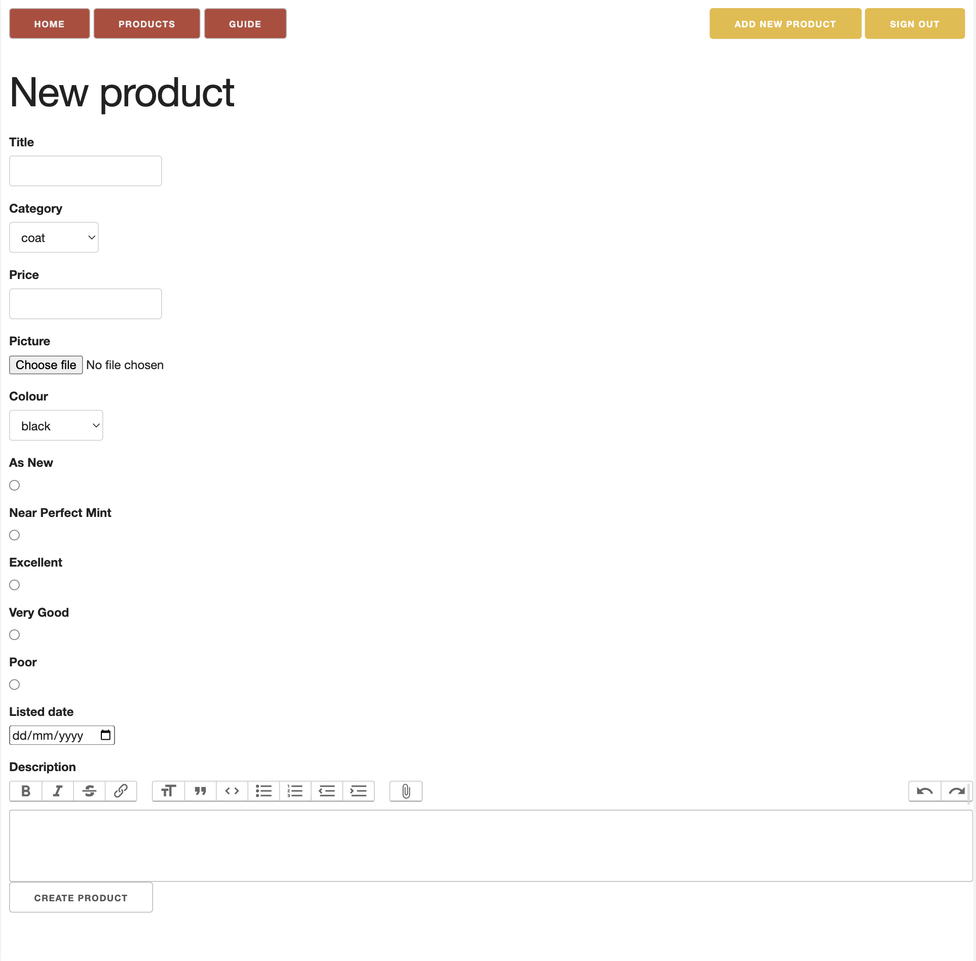
Notes:
When a User adds a new product, the new product page looks like the right screenshot here.
To create the product a User clicks the ”Create product” button at the bottom

Slide 27
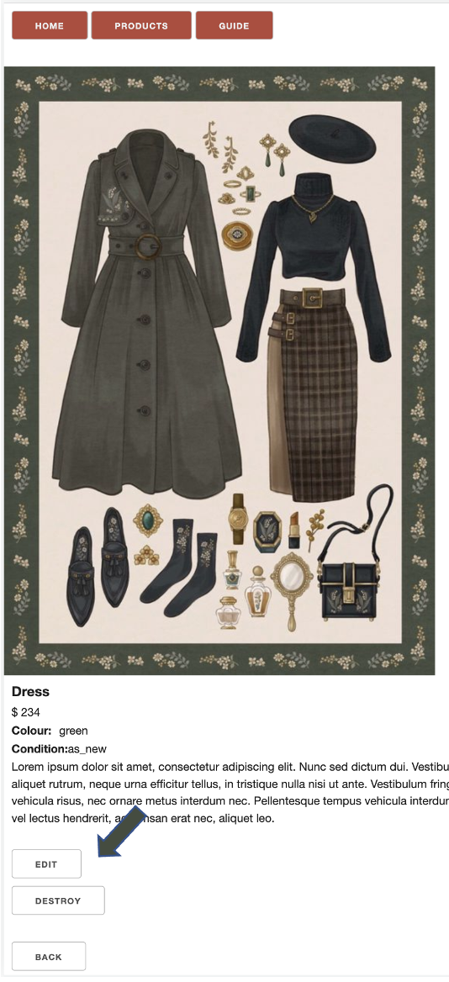
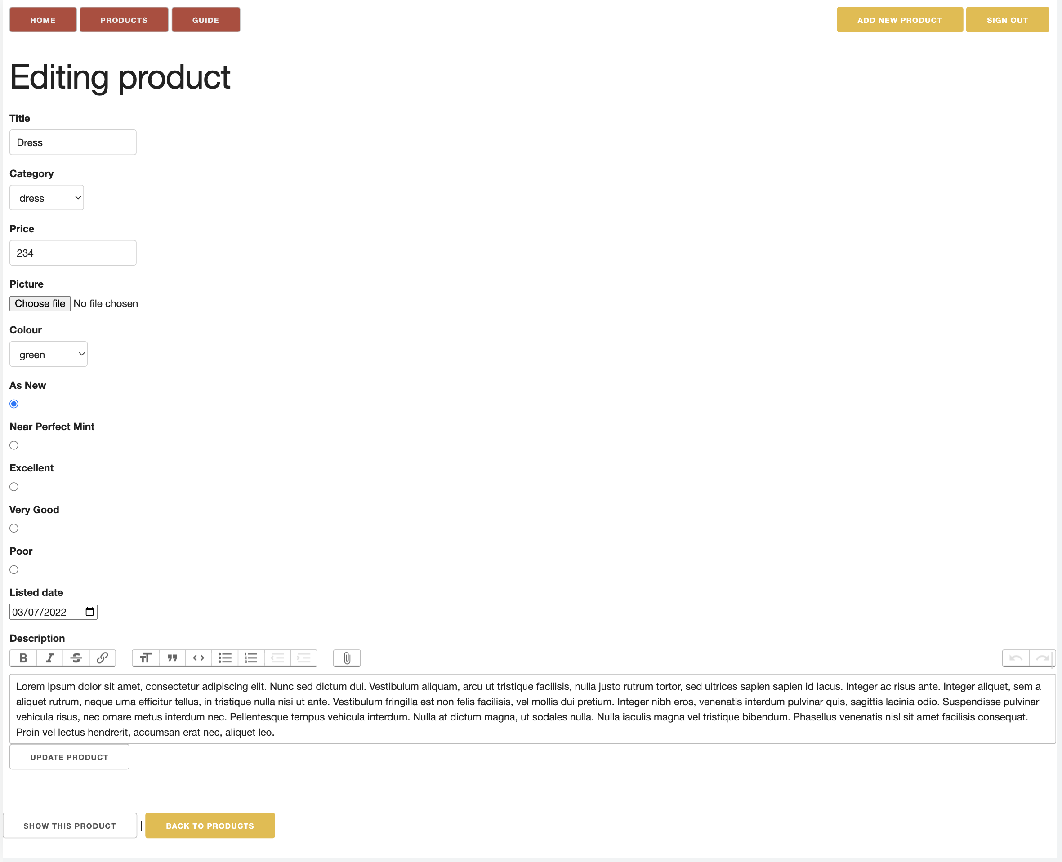
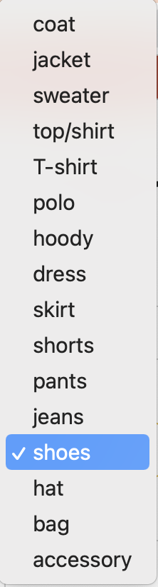
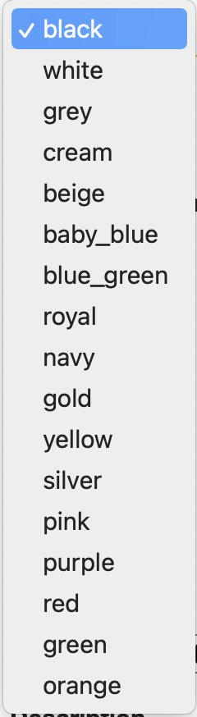
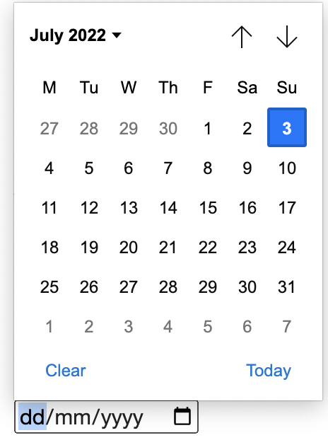
Category
Colour
Listed date
Notes:
After creating a new product, you can edit the product anytime by clicking the “edit” button.
The category and colour fields are dropdowns.
The listed date field uses a date picker
To save the edits a User clicked the “update product” button at the bottom.

Slide 28
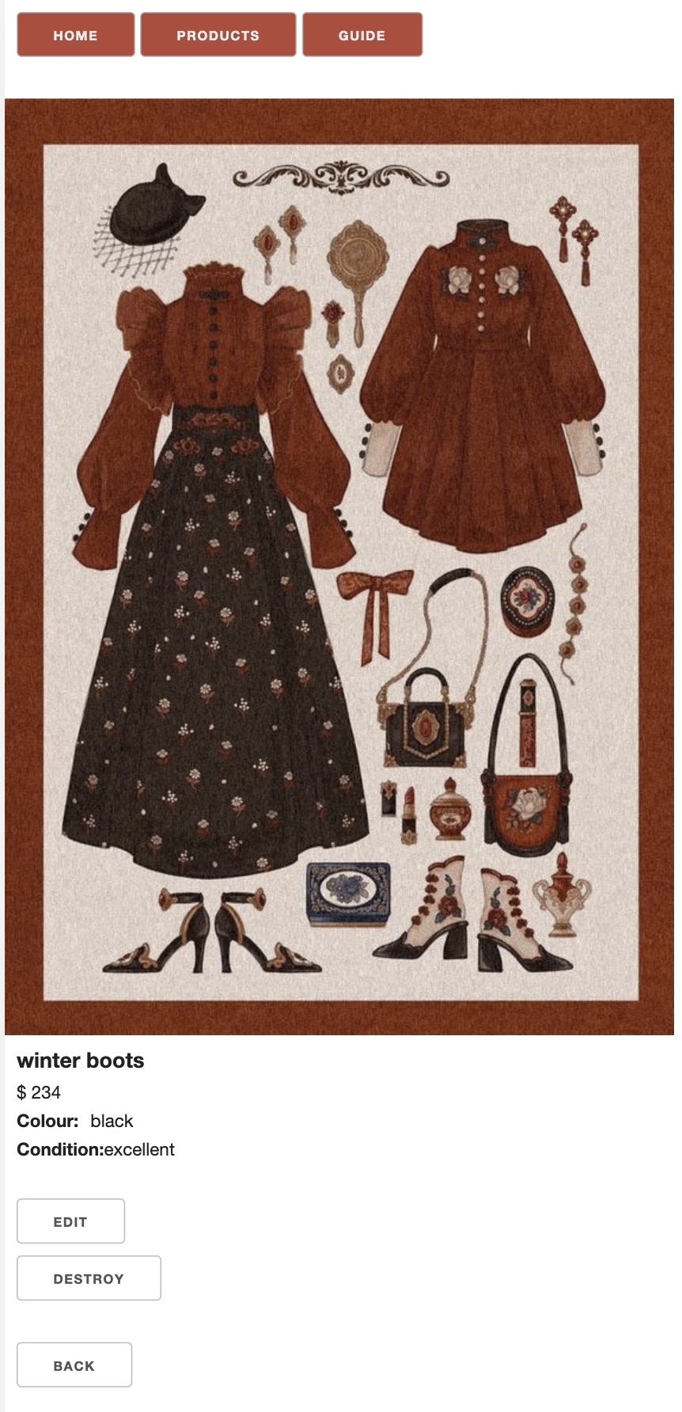
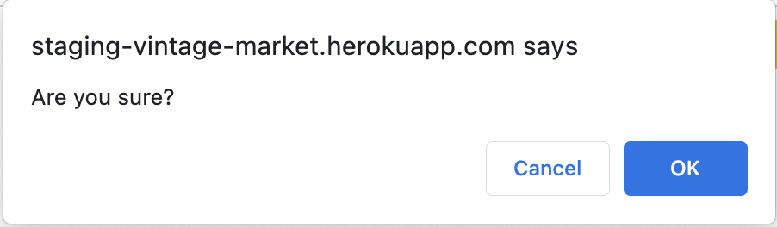
Notes:
A User can delete products they have added by clicking the “destroy” button.
There is a check popup for safety.

Slide 29
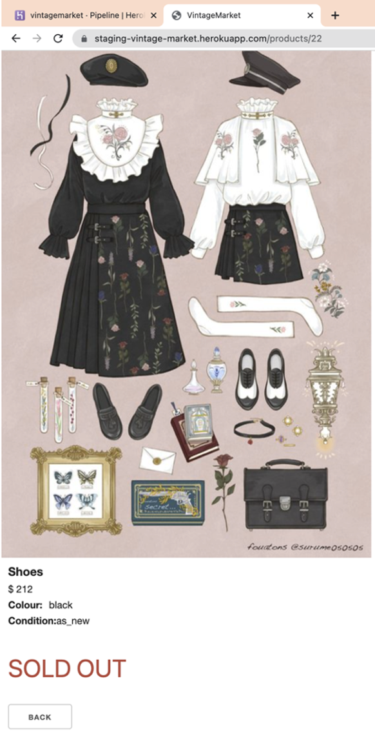
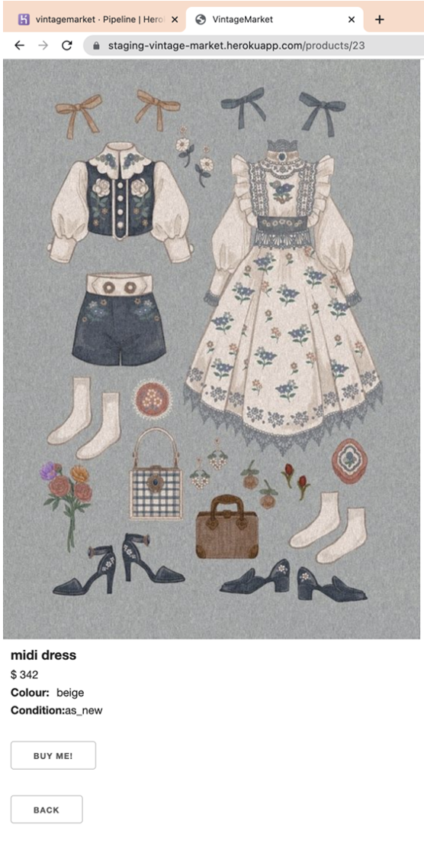
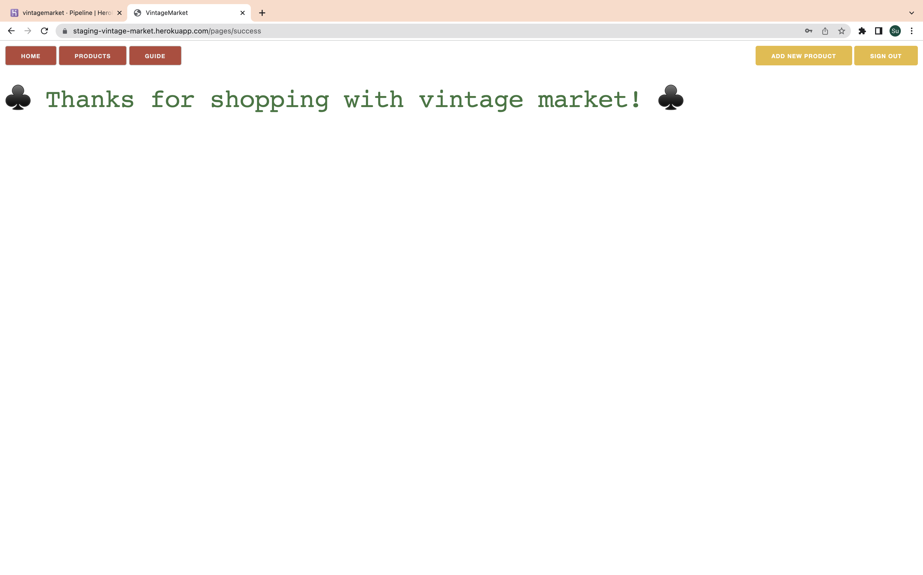
Notes:
As a buyer, when viewing a product, they can purchase by clicking the “buy me” button. This then shows the successful message.
If the product has already been purchased, it will show a “sold out” message in red.

Slide 30
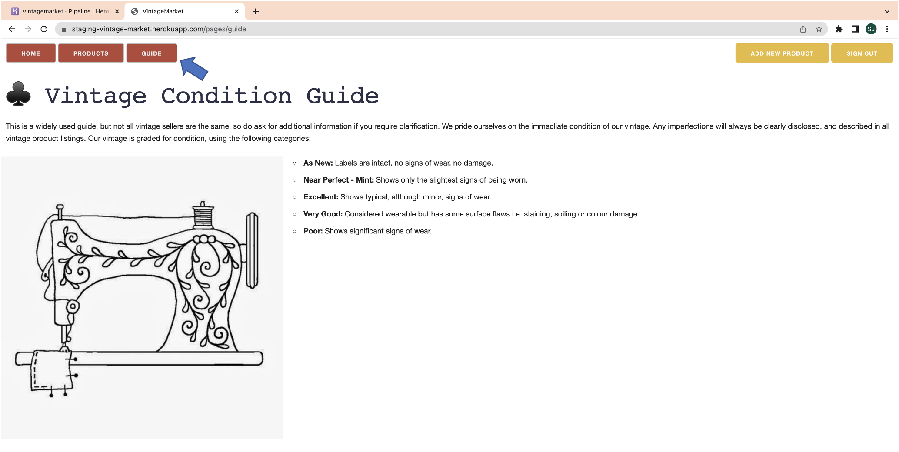
Notes:
This page shows the condition guide.

Slide 31
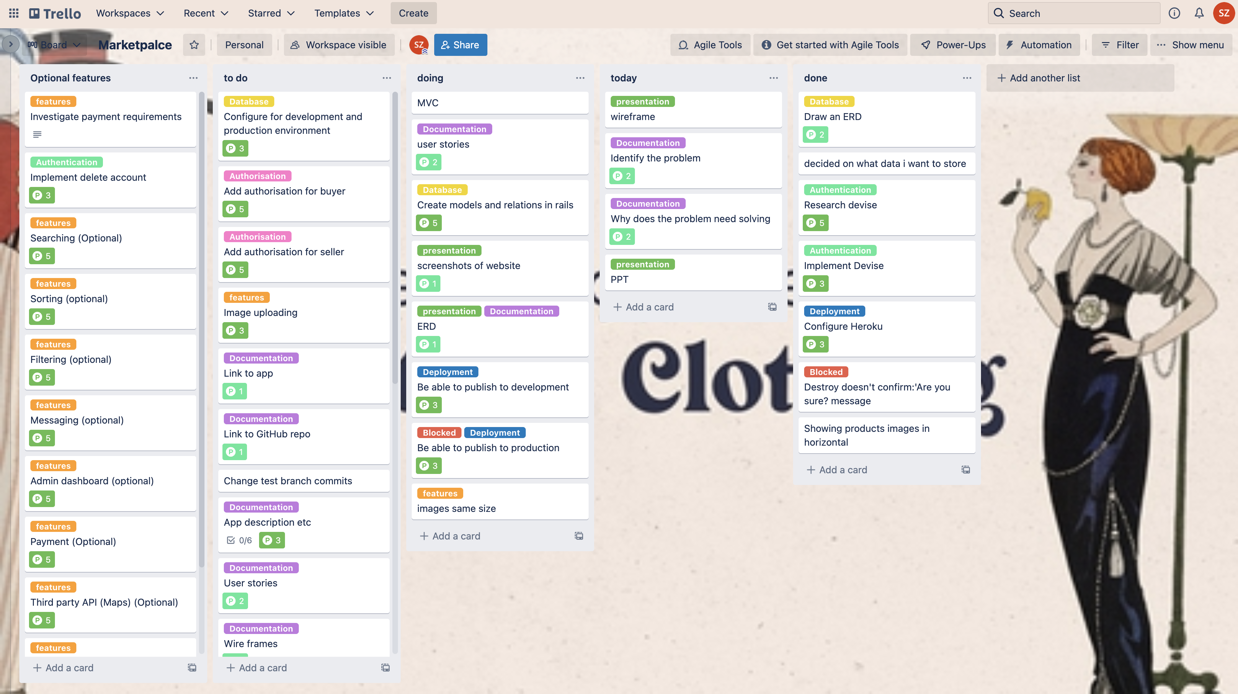
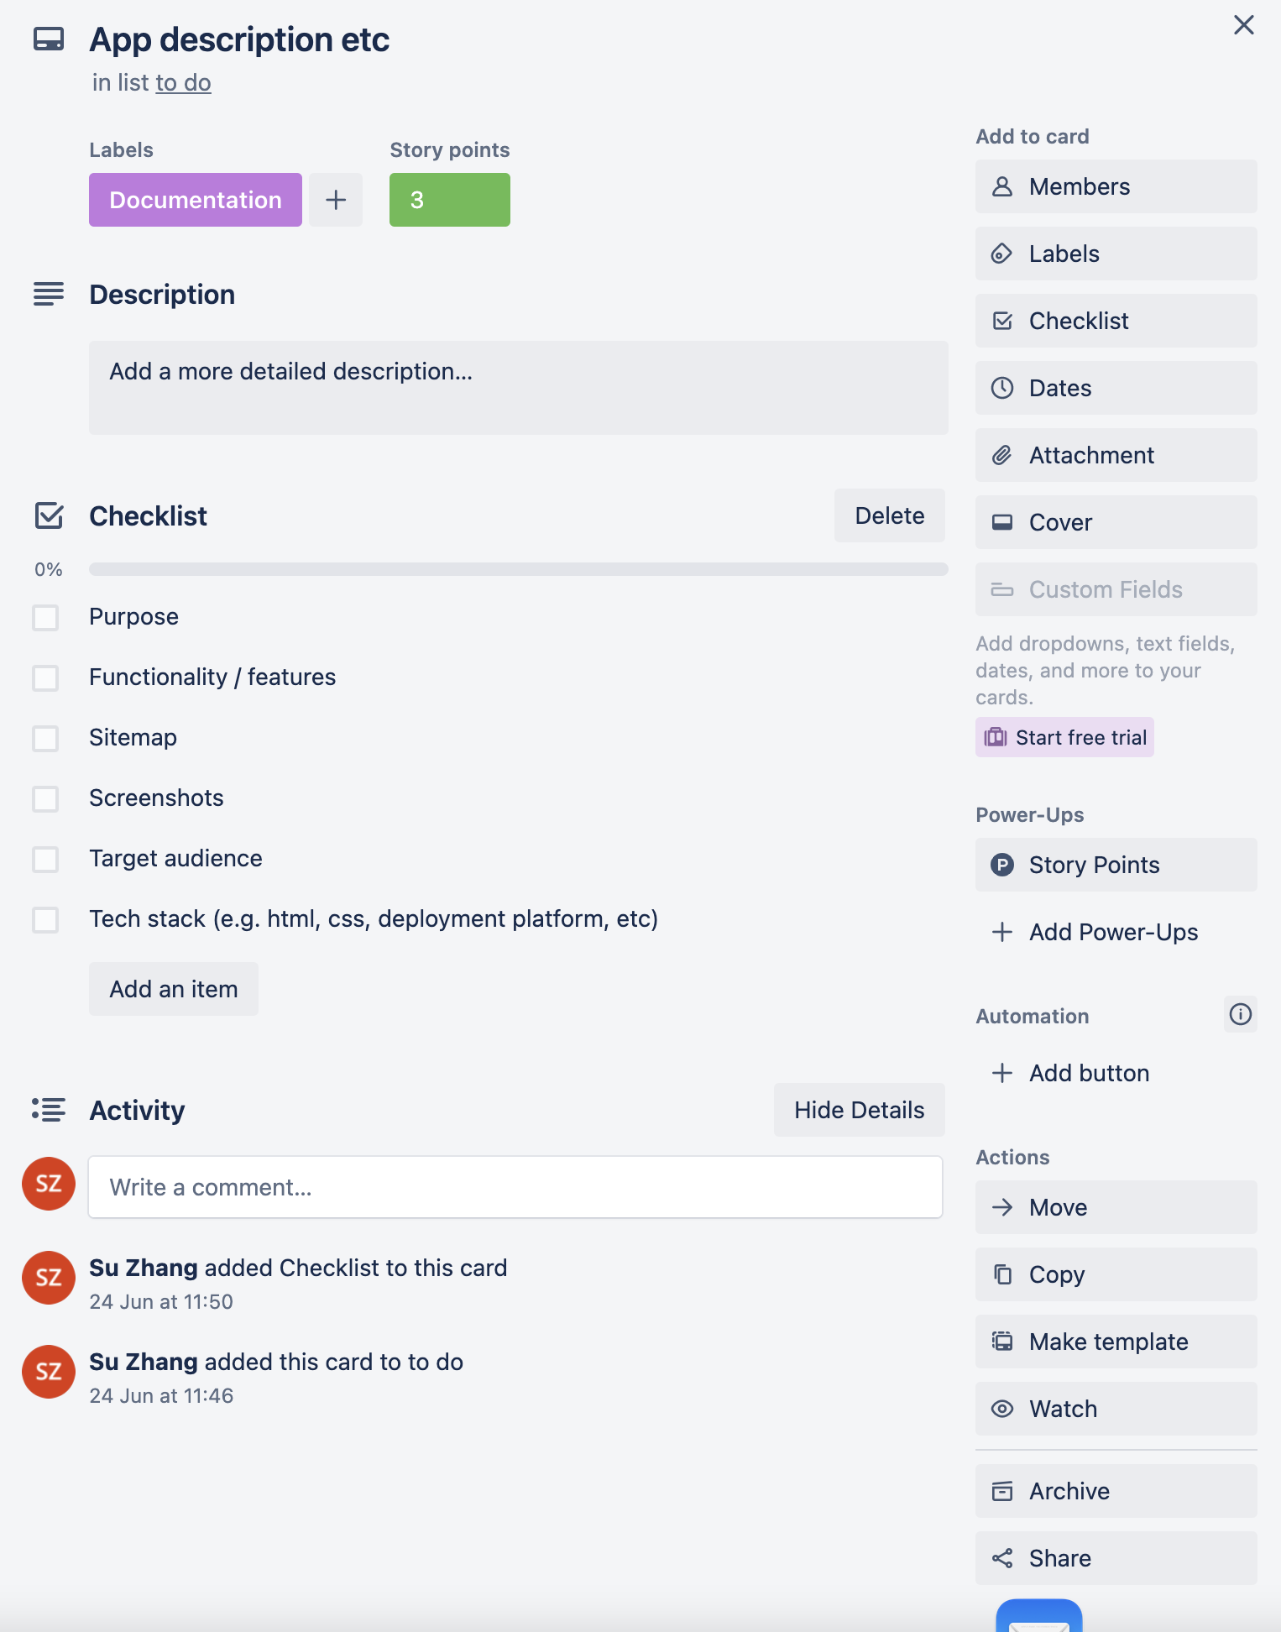
Build Process
Notes:
For the development and build process I used Trello to track the tasks I needed to do.
Each task has a category and also story points.

Slide 32
Thank You!
Notes:
Thank you for listening
If I still have time, I can also show you how to buy a product on my website.

